Slide 1

EZRA

Slide 2
EZRA
Or do you not know that your body is the temple of the Holy Spirit who is in you, whom you have from God, and you are not your own?
1 Corinthians 6.19

Slide 3
EZRA
Do you not know that you are the temple of God and that the Spirit of God dwells in you?
You is plural
1 Corinthians 3.16

Slide 4
EZRA
Two distinct periods:
Chapters 1-6 ~ 538-515 BC – rebuilding the Temple
Cyrus’ decree
Chapters 7-10 ~ 458 BC – Ezra's return from Babylon
Xerxes’ decree

Slide 5
EZRA
Written in Aramaic:
4:18-6:18
7:12-26

Slide 6
EZRA
10 For thus says the Lord: After seventy years are completed at Babylon, I will visit you and perform My good word toward you, and cause you to return to this place.
¹¹ For I know the thoughts that I think toward you, says the Lord, thoughts of peace and not of evil, to give you a future and a hope.
Jeremiah 29.10-11

Slide 7
EZRA
1st Deportation 605 BC
2nd Deportation 586 BC
675 BC
575 BC
475 BC
375 BC
1st Return of Exiles
537 BC
Completion of Temeple 515 BC
Timeline of 70 year captivity

Slide 8
EZRA
²⁸ Who says of Cyrus, ‘He is My shepherd,
And he shall perform all My pleasure,
Saying to Jerusalem, “You shall be built,”
And to the temple, “Your foundation shall be laid.” ’
¹ Thus says the Lord to His anointed,
To Cyrus, whose right hand I have held—
To subdue nations before him
And hidden riches of secret places,
That you may know that I, the Lord,
Who call you by your name,
Am the God of Israel.
⁴ For Jacob My servant’s sake,
And Israel My elect,
I have even called you by your name;
I have named you, though you have not known Me
And loose the armor of kings,
To open before him the double doors,
So that the gates will not be shut:
² I will go before you
And make the crooked places straight;
I will break in pieces the gates of bronze
And cut the bars of iron.
³ I will give you the treasures of darkness
Isaiah 44:28-45:4

Slide 9
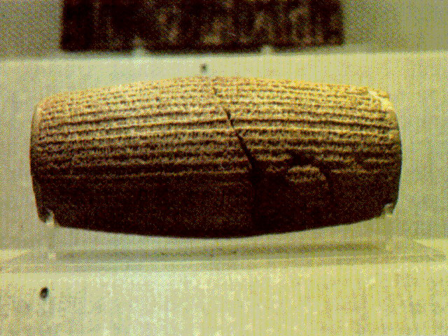
EZRA
The Cyrus’ Cylinder

Slide 10
EZRA
Daniel’s 70 7’s prophecy 539 BC
675 BC
575 BC
475 BC
375 BC
Cyrus’ Decree
538 BC
Temple Dedication 515 BC
Isaiah’s Prophecy 725 BC?
Remnant Returns
537 BC
Ezra comes from Babylon
458BC
Timeline of Ezra

Slide 11
EZRA
Cambyses II
Esther crowned, 483 BC
Cyrus
Darius I
Xerxes I
Artaxerxes
530 BC
500 BC
470 BC
440 BC
Remnant Returns 537 BC
Work Resumed 520 BC
Ezra Comes w/ 2nd Group 458 BC
Cyrus’ Decree 538 BC
Opposition
Stops Work
535 BC
Temple Dedication 515 BC
Nehemiah Comes
445 BC
Timeline of Ezra

Slide 12
EZRA
"For who has despised the day of small things?
For these seven rejoice to see
The plumb line in the hand of Zerubbabel
They are the eyes of the Lord,
Which scan to and fro throughout the whole earth."
Zechariah 9.10

Slide 13
EZRA
⁵ Now therefore, thus says the Lord of hosts: "Consider your ways!
⁶ "You have sown much, and bring in little;
You eat, but do not have enough;
You drink, but you are not filled with drink;
You clothe yourselves, but no one is warm;
And he who earns wages,
Earns wages to put into a bag with holes."
Haggai 1.5-6

Slide 14
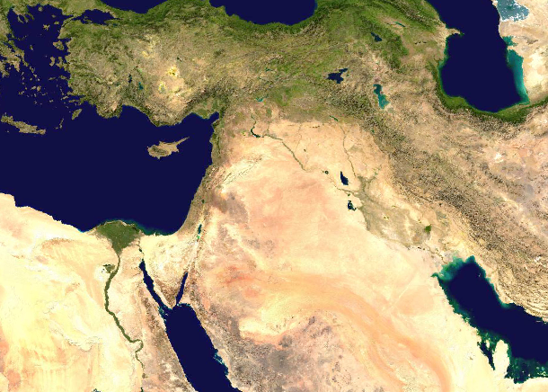
EZRA
Ecbatana
Jerusalem
900 mile journey

Slide 15
EZRA
The Levites: the sons of Jeshua and Kadmiel, of the sons of Hodaviah, seventy-four.
Only 74 of the almost 50,000 returnees were Levites
Ezra 2.4

Slide 16
EZRA
destroy them. You shall make no covenant with them nor show mercy to them. ³ Nor shall you make marriages with them. You shall not give your daughter to their son, nor take their daughter for your son. ⁴ For they will turn your sons away from following Me, to serve other gods; so the anger of the Lord will be aroused against you and destroy you suddenly.
¹ When the Lord your God brings you into the land which you go to possess, and has cast out many nations before you, the Hittites and the Girgashites and the Amorites and the Canaanites and the Perizzites and the Hivites and the Jebusites, seven nations greater and mightier than you, ² and when the Lord your God delivers them over to you, you shall conquer them and utterly
Deuteronomy 7.1-4

Slide 17
EZRA
For I desire mercy and not sacrifice,
And the knowledge of God more than burnt offerings.
Hosea 6.6

Slide 18
EZRA
Pagan wives ~ KJV, strange wives

Slide 19
EZRA
For there is nothing covered that will not be revealed, nor hidden that will not be known.
Luke 12.2

